Slide 1

iMarine (EU FP7 - 283644)
FORTH activities
Yannis Marketakis
Notes:
The topic of this presentation is ontology-based integration in iMarine

Slide 2
Outline
iMarine, Introduction and description
FORTH involvement
Outcomes
MarineTLO
MarineTLO-based warehouse
MatWare
Ichthys
Xsearch
Xlink
Links and References
Publications

Slide 3
The iMarine Project
iMarine
Data e-Infrastructure Initiative for Fisheries Management and Conservation of Marine Living Resources
Follow-up of:
DILIGENT (2004-2007), D4Science (2008-2010), D4Science-II (2010-2012)
Duration: Nov 2011 – Sep 2014 (35 months)
Budget: 6.3 million €
Partners: 13 (GR, IT, UK, CH, FR, PH, BR)

Slide 4
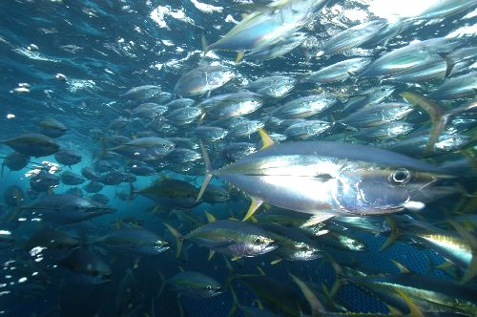
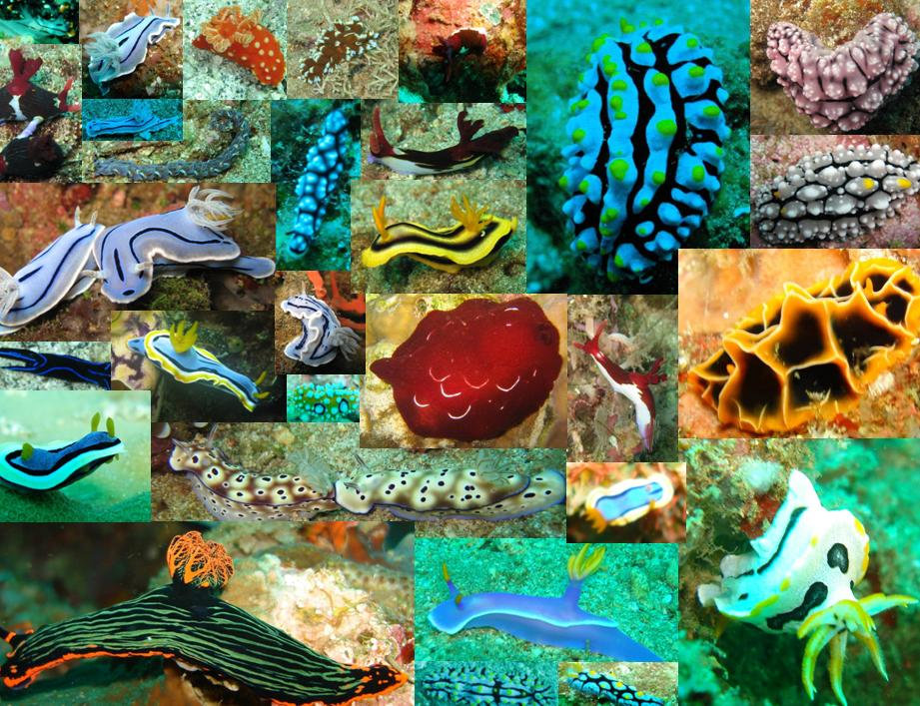
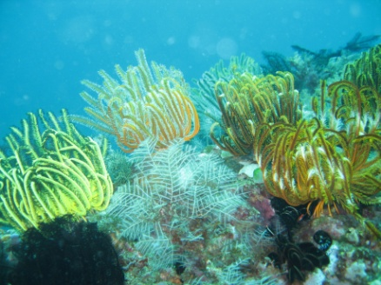
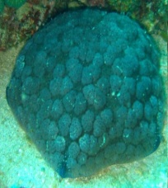
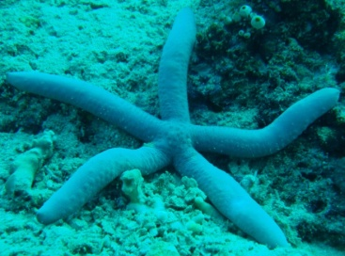
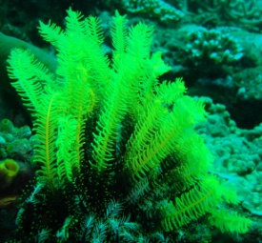
The iMarine Project
Launch an Initiative to establish and operate a data infrastructure supporting the principles of the Ecosystem Approach to Fisheries Management and Conservation of Marine Living Resources
iMarine Virtual Research Environments (VREs)
provide users with a web-based set of facilities (including services, data and computational facilities) tailored to serve the needs of a Community of Practice

Slide 5
FORTH Involvement
Effort: 38 PMs
Budget: ~ 310 K €
Data Integration
Harmonize the metadata and semantics of marine datasets
Construct a warehouse containing information from marine datasets
Semantic Enrichment of marine-related information
Offer a set of services for supporting the enrichment

Slide 6
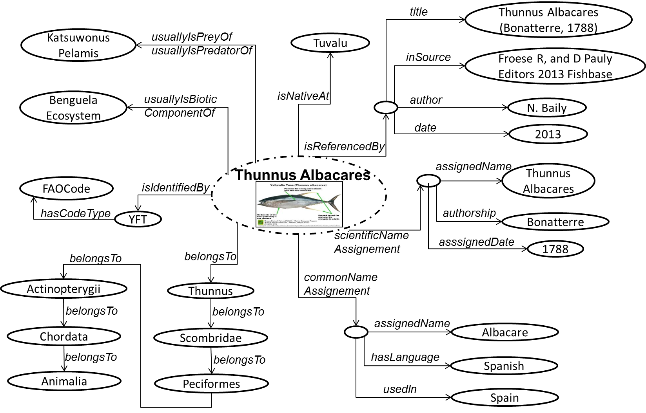
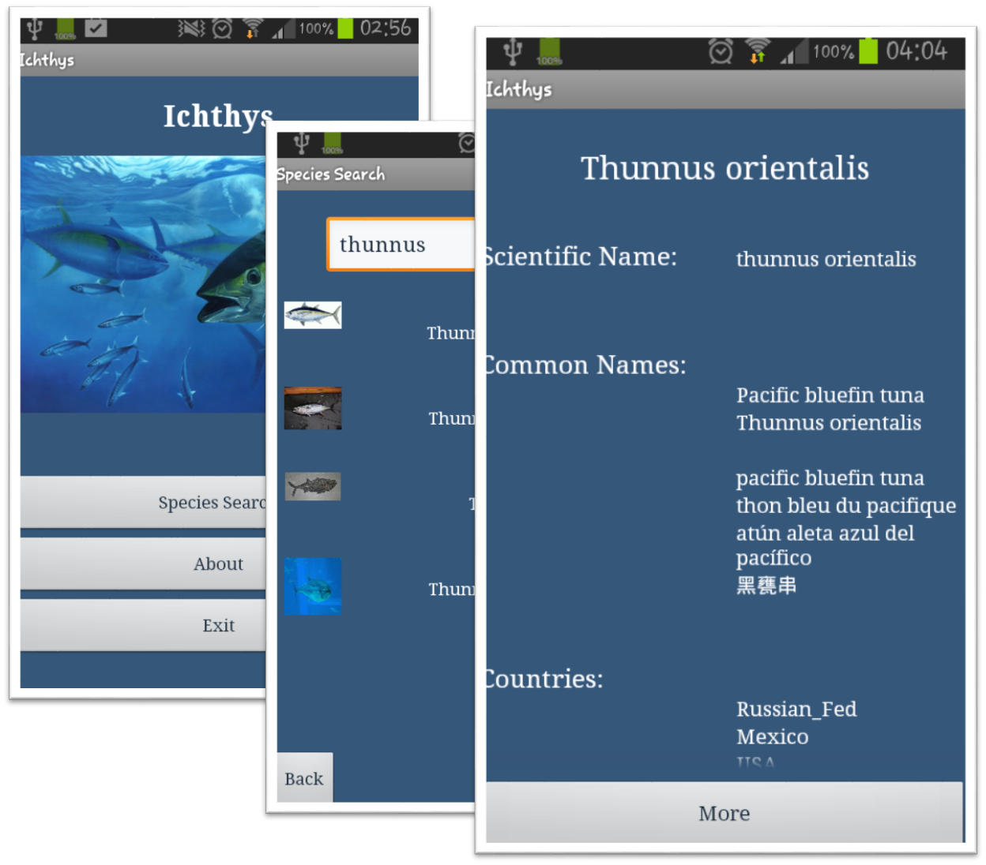
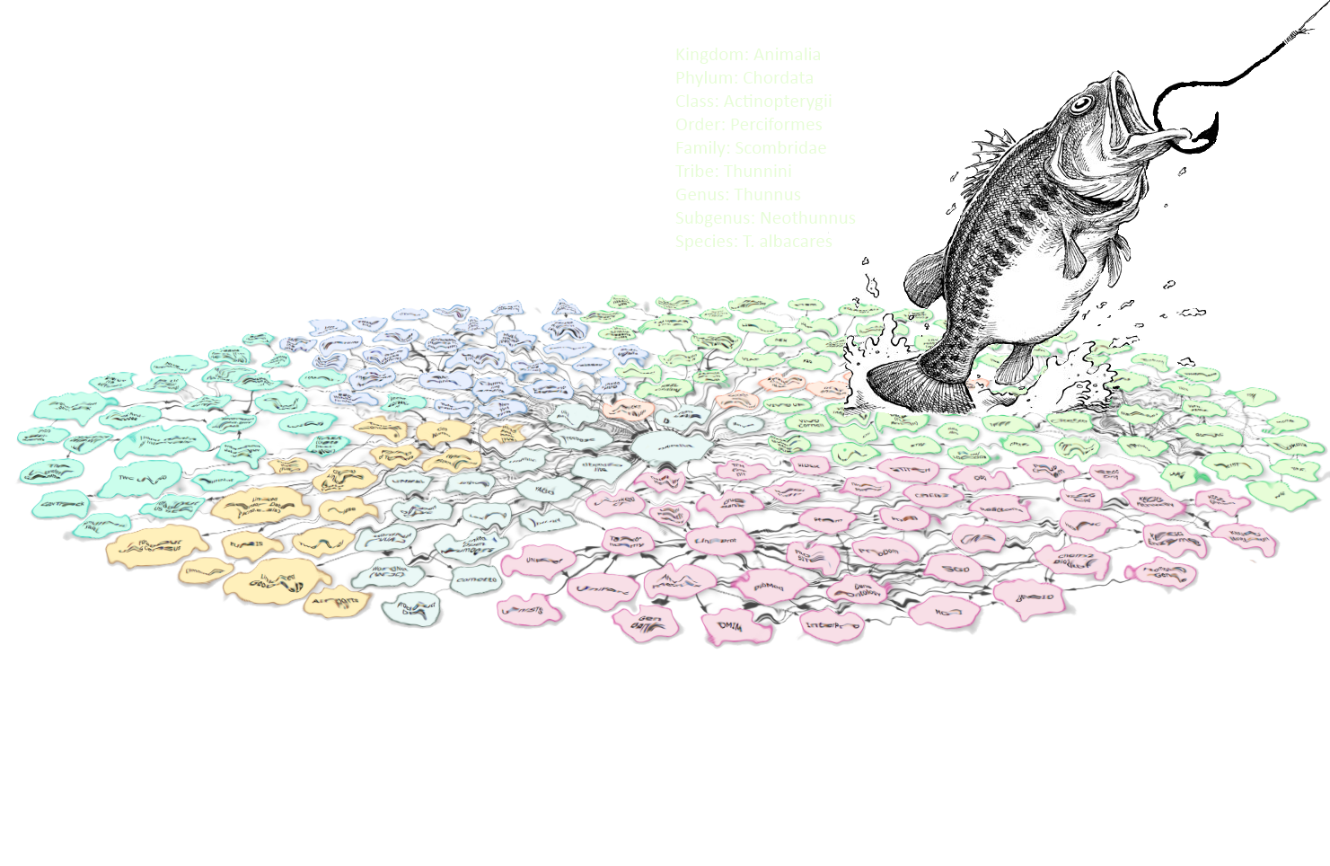
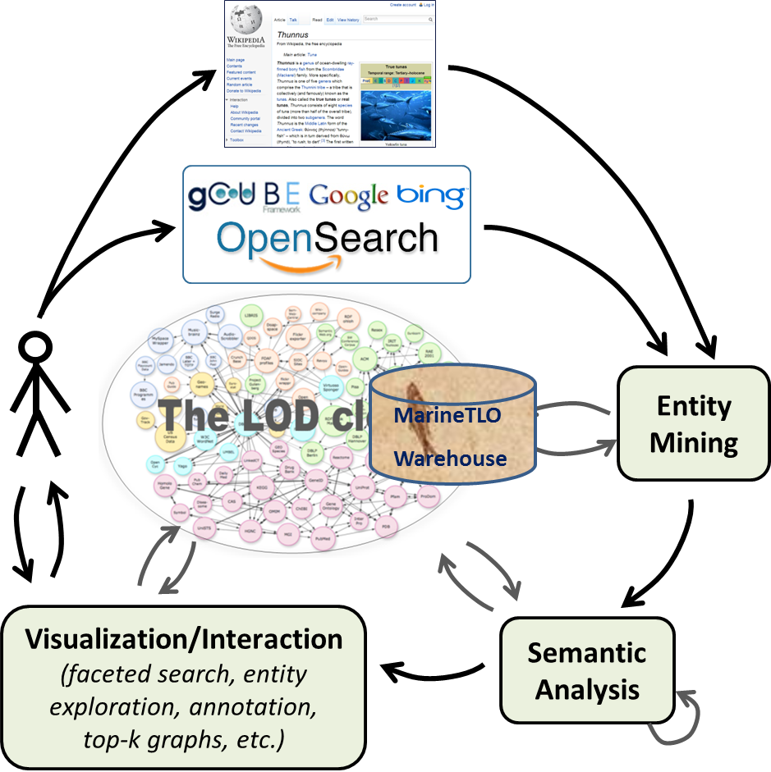

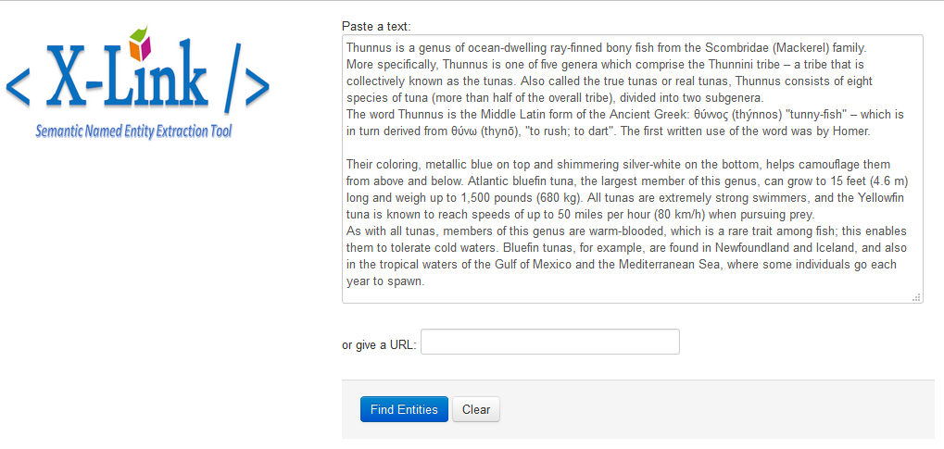

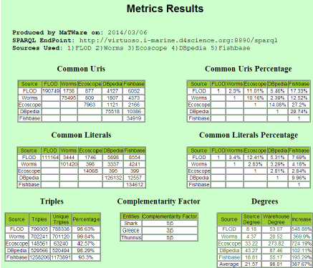
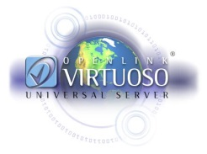
MarineTLO
MarineTLO-based
Warehouse
Ichthys
MatWare
XSearch
XLink

Slide 7

MarineTLO
Harmonization of metadata and semantics of currently existing data models (describing marine resources)
FishBase
scientific names,
bibliographic
citations, etc.
FLOD
DBpedia
water area
codes
common names,
recipes, etc.
ECOSCOPE
prey-predator,
ecosystems,
information
WoRMS
taxonomic
information
Cannot answer queries like:
Find the FAO water area code and the scientific names of the fish
species that are predators of the species which is usually called “κιτρινόπτερος τόνος”
in Greece, and belong to the genus “Carcharodon”

Slide 8
MarineTLO
It is a top level ontology for the marine domain offering fundamental abstractions for querying. It is therefore appropriate for using it as the conceptual backbone for information integration (the adoption of a TLO implies reduced effort for improving and evolving, and reduced effort for constructing mappings).
As a product
The latest “core” version of MarineTLO (v.4)
Was released on July 2014, contains 127 classes and 81 properties, aims at covering any part of the marine domain
The latest “operational” version for the needs of iMarine (v.4)
Aims at integrating FLOD, ECOSCOPE, WoRMS, part of Dbpedia and part of FishBase. It contains the “core version” and classes/properties related to the particular sources used. In total it contains 151 classes and 116 properties.
Notes:
==
MarineTLO aims at being a global core model that
provides a common, agreed-upon and understanding of the concepts and relationships holding in the marine domain to enable knowledge sharing, information exchanging and integration between heterogeneous sources
covers with suitable abstractions the marine domain to enable the most fundamental queries, can be extended to any level of detail on demand, and
allows data originating from distinct sources to be adequately mapped and integrated
MarineTLO is not supposed to be the single ontology covering the entirety of what exists
Benefits:
reduced effort for improving and evolving : the focus is given on one model, rather than many (the results are beneficial for the entire community)
reduced effort for constructing mappings: this approach avoids the inevitable combinatorial explosion and complexities that results from pair-wise mappings between individual metadata formats and/or ontologies
The latest version was released

Slide 9
MarineTLO
MarineTLO-based
Warehouse
Ichthys
MatWare
XSearch
XLink

Slide 10
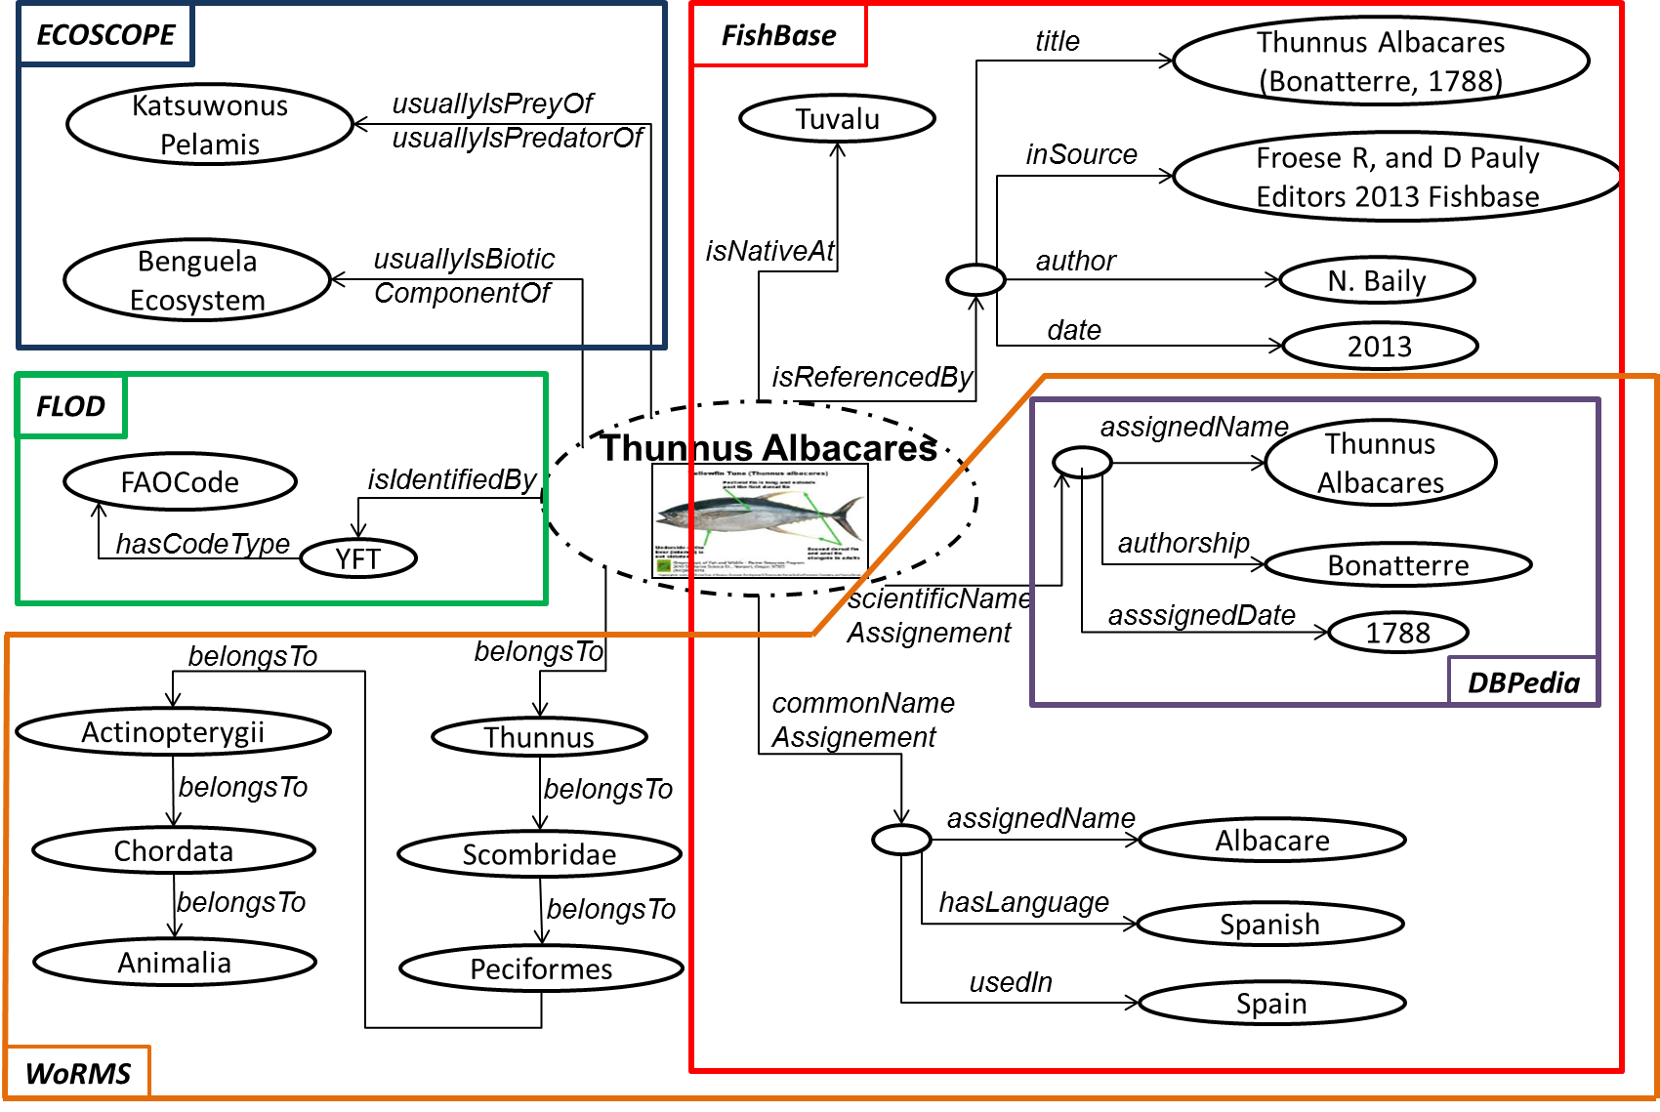
MarineTLO-based Warehouse

Slide 11


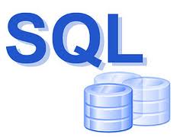


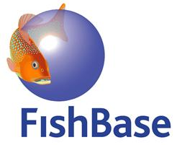

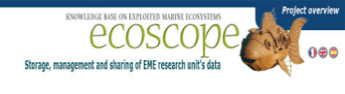

Warehouse V4
MarineTLO
FLOD
sameAs Links
Ecoscope
sameAs Links
DBpedia
sameAs Links
WoRMS
sameAs Links
Fishbase
sameAs Links
FLOD-to-TLO mapping
ECOSCOPE-to-TLO
mapping
DBpedia-to-TLO
mapping
FLOD
ECOSCOPE
WoRMS (part of)
DBpedia
(part of)
FishBase
(part of)
Transform and Ingest
Transform and Ingest
Transform and Ingest
Transform and Ingest
Transform and Ingest
FLOD
ECOSCOPE
WoRMS (part of)
DBpedia
(part of)
FishBase
(part of)

Slide 12
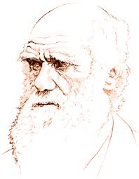

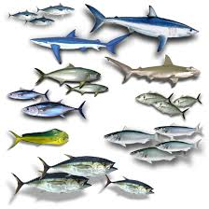
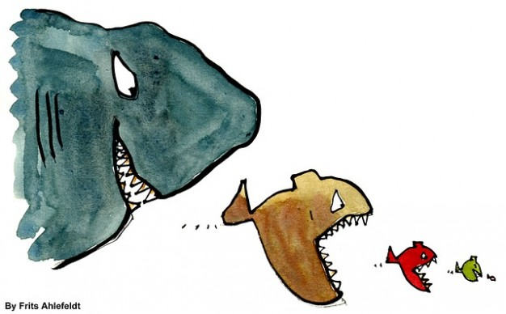
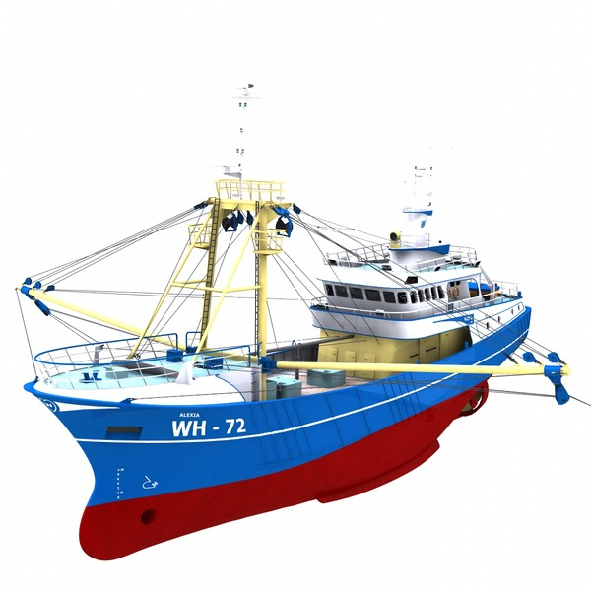
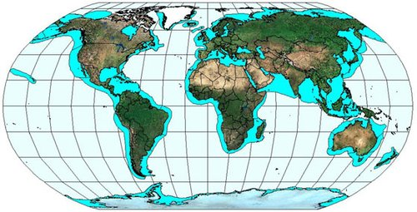
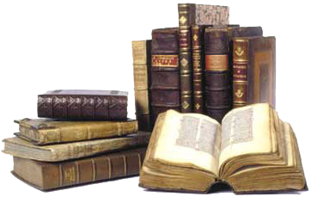
MarineTLO-based Warehouse
53,797 Scientific Names
12,752 Authorships
155,510 Common Names
5.5M Triples
53,797 Species
2,054 Predators
853 Ecosystems 47 Water Areas
294 Countries 160 EEZ
90 Vessel Types
112 Gear Types
13,131 Bibliography resources
3,206 Statistic Indicators

Slide 13
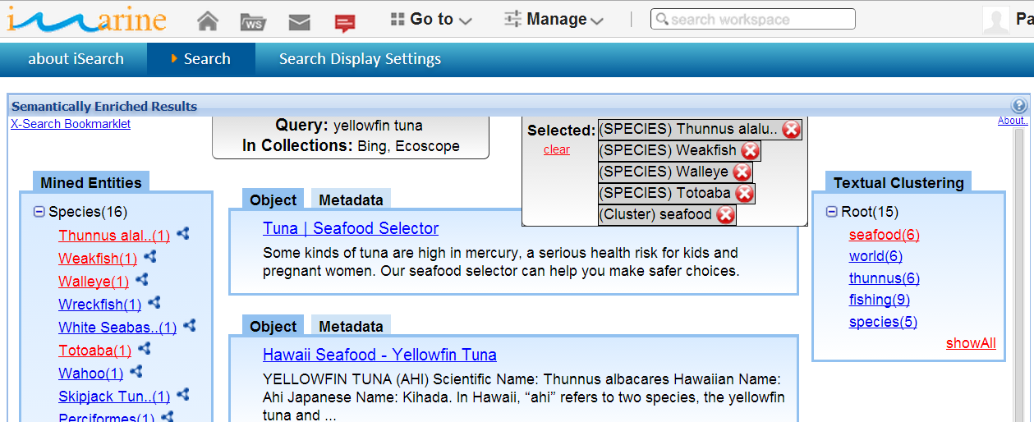
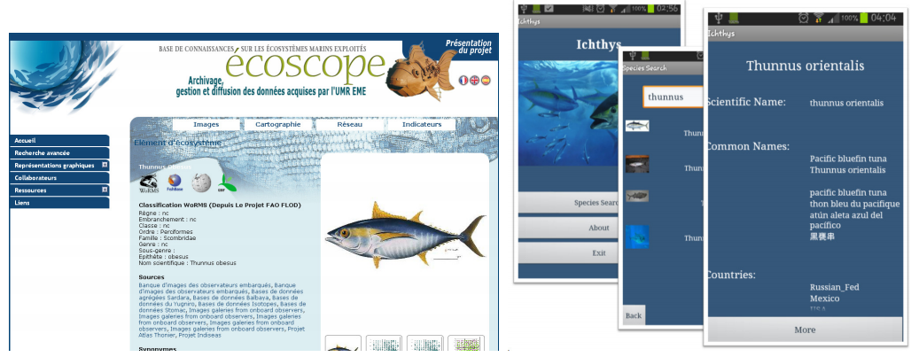
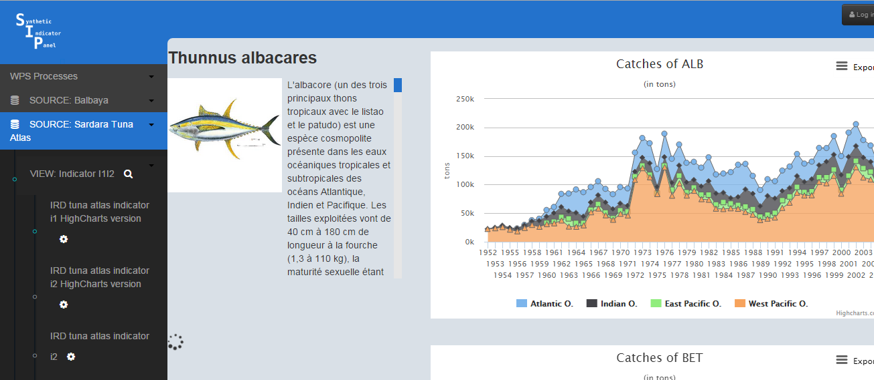
MarineTLO-based Warehouse
The warehouse has been exploited for
generating fact sheets (and other applications/services of IRD)
semantic Post-Processing of Search Results (see more below)
browsing their contents
Notes:
The warehouse is in use by ….
Also various individuals have requested access

Slide 14
MarineTLO
MarineTLO-based
Warehouse
Ichthys
MatWare
XSearch
XLink

Slide 15
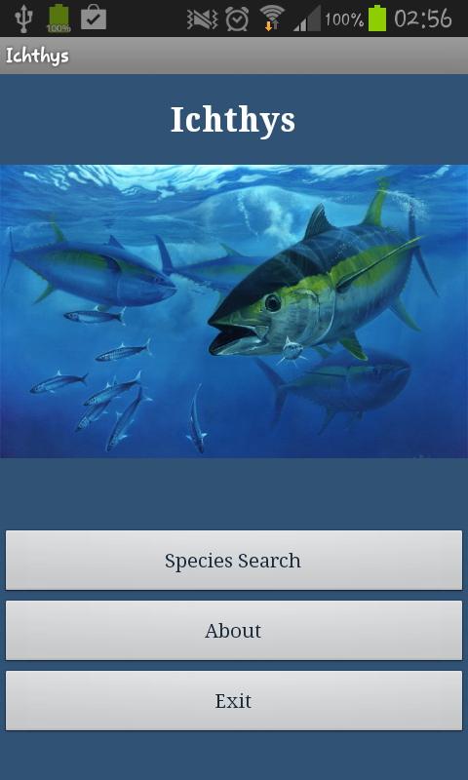
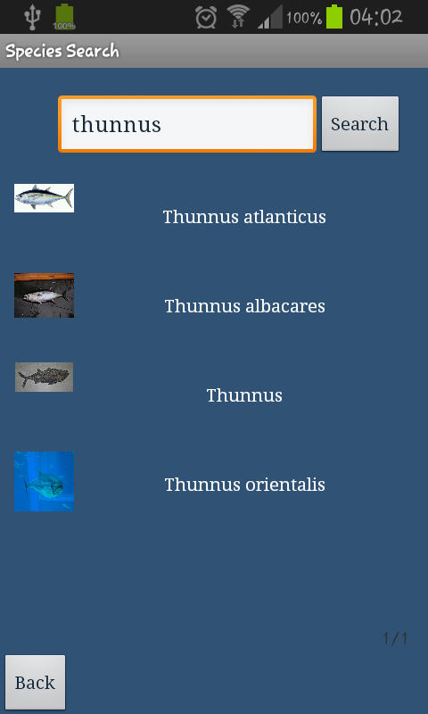
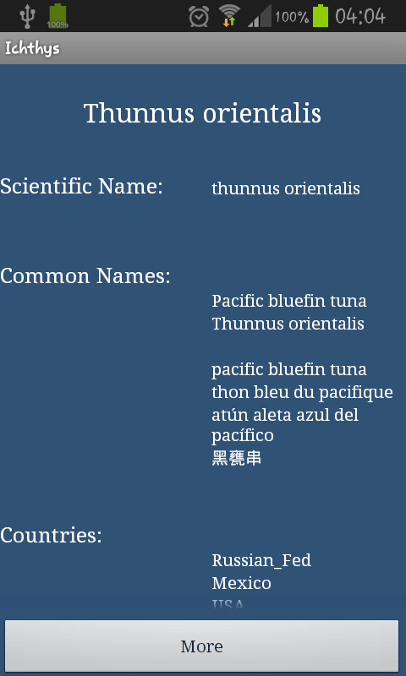
Ichthys Android application

Slide 16
MarineTLO
MarineTLO-based
Warehouse
Ichthys
MatWare
XSearch
XLink

Slide 17
MatWare
Key Questions
How to define the objectives and the scope of such a warehouse?
How to connect the fetched pieces of information?
How to test that its contents meet the objectives?
How to measure the quality of the warehouse?
How to tackle the various issues of provenance that arise?
How to automate the construction/maintenance process?
Notes:
and for this reason we introduce various metrics for quantifying its connectivity,
and consequently its ability to answer complex queries.
We demonstrate the behavior of these metrics in the context
of a real and operational semantic warehouse. The results
are very promising: the proposed metrics-based matrixes allow
someone to get an overview of the contribution (to the
warehouse) of each source and to quantify the benefit of the
entire warehouse. The later is useful also for monitoring the
quality of the warehouse after each reconstruction.

Slide 18
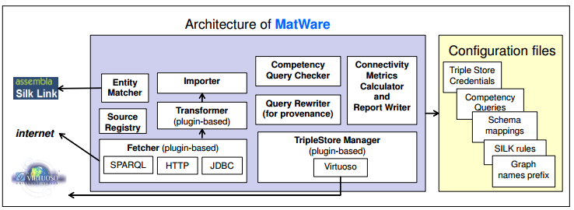
MatWare
The Process:
Downloads and transforms data from remote sources.
Ingests them into semantic repositories (i.e. Virtuoso triplestore).
Applies transformation rules, and creates sameAs links to assist complex query answering.
Computes several quality metrics as regards the connectivity of the warehouse.
Refreshes the warehouse if the data derived from remote sources change.

Slide 19


MatWare
Define requirements in terms
of competency queries
produces
uses
Queries
MatWare
Fetch the data from the selected sources
(SPARQL endpoints, services, etc)
produces
Triples
MatWare
Input for
Transform Data
MatWare
Ingest to the Warehouse
creates
MatWare
Inspect the connectivity of the Warehouse
uses
produces
Rules for Instance Matching
MatWare +
Formulate rules creating sameAs relationships
Input for
MatWare
Apply the rules to the warehouse
uses
produces
MatWare
Ingest the sameAs relationships
to the warehouse
Input for
sameAs triples
MatWare
Creation and Ingestion of VoID triples
enriches
Warehouse
MatWare
uses
Test and evaluate the Warehouse (using the competency queries and the conn. metrics)
Notes:
The entirely new ones are
1/ Inspect the connectivity
2/ creation and ingestion of void triples

Slide 20
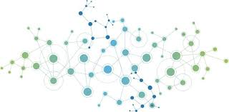
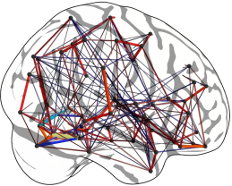
MatWare - Connectivty
Connectivity has two main aspects: Schema and Instance
Regarding Schema Connectivity we use a top level ontology (MarineTLO) and schema mappings in order to associate the fetched data with the schema of the top level ontology.
Based on these MatWare transforms and then ingests the fetched data
As regards Instance Connectivity one has to inspect and test the
connectivity of the “draft” warehouse through the competency queries, and a number of connectivity metrics that we have defined and then formulate rules for instance matching

Slide 21
MatWare - Connectivity
Why is it useful to measure Connectivity?
For assessing how much the aggregated content is connected
For getting an overview of the warehouse
For quantifying the value of the warehouse (query capabilities)
Poor connectivity affects negatively the query capabilities of the warehouse
For making easier its monitoring after reconstruction
For measuring the contribution of each source to the warehouse, and hence deciding which sources to keep or exclude (there are already hundreds of SPARQL endpoints). Identification of redundant or unconnected sources

Slide 22
MatWare - On comparing URIs
Exact String Equality
DBP#thunnus_albacares = DBP#thunnus_albacares
DBP#thunnus_albacares ≠ ECO#thunnus_albacares
Suffix Canonicalization
DBP#thunnus_albacares = ECO#thunnus_albacares
DBP#thunnus_albacares = FIS#ThunnusAlbacares
Entity Matching
DBP#thunnus_albacares = FLD#0912312-312e20312 <DBP#thunnus_albacares owl:sameAs FLD#0912312-312e20312>

Slide 23
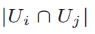
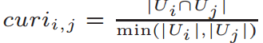
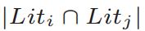
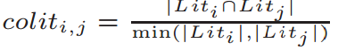
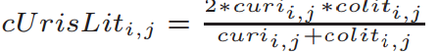
MatWare – Connectivity metrics
For pairs of sources
Common URIs
Common literals
Harmonic mean of common resources

Slide 24
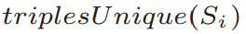
MatWare – Connectivity metrics
For each source
Avg degree (+ increment)
Unique triples

Slide 25
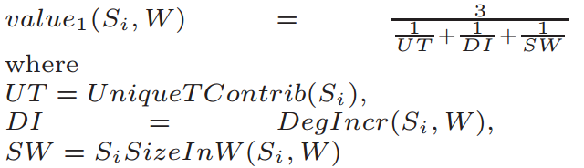
MatWare – Connectivity metrics
For each source
Complementarity factor
Value of a source

Slide 26
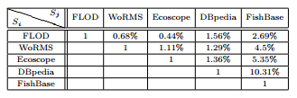
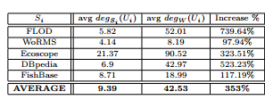
MatWare – Connectivity metrics
Common URIs
Average Degree

Slide 27
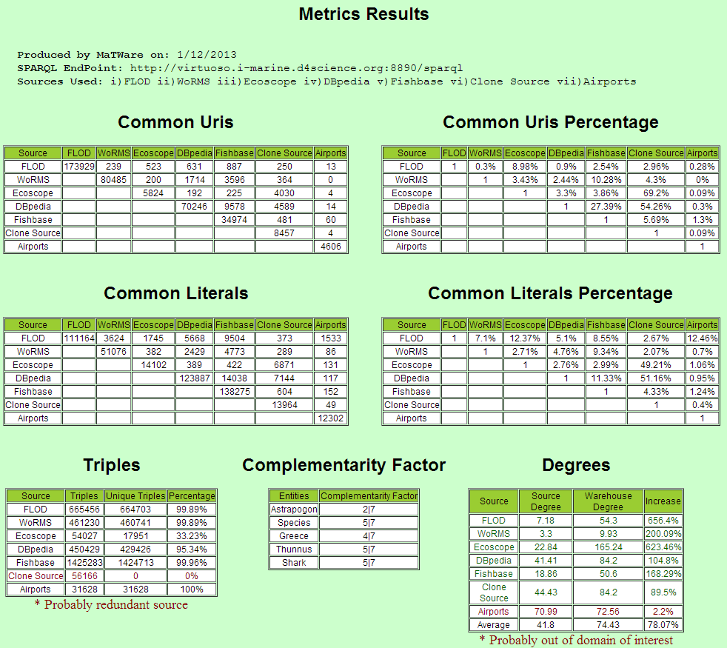
Connectivity Metrics: As produced by MatWare
Notes:
The calculartion of these metrics is automated by matware.

Slide 28
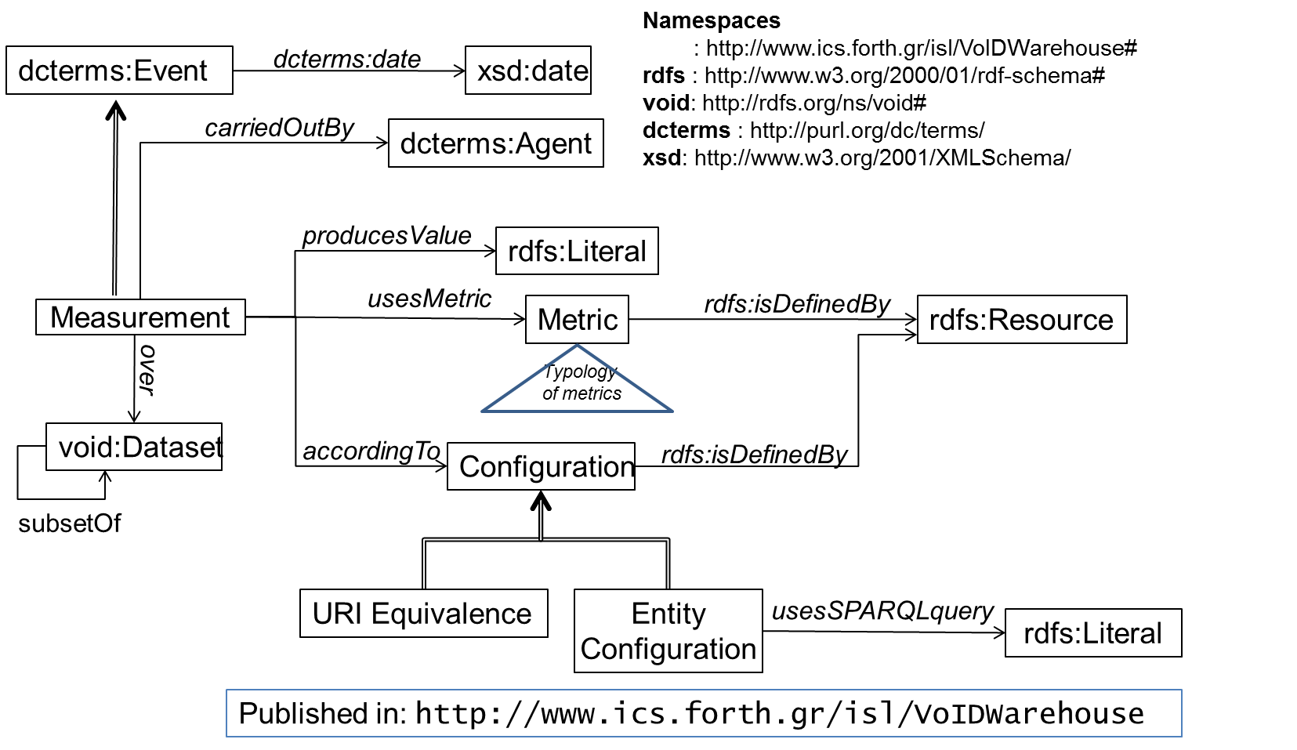
Connectivity Metrics: Exchanging
Then we encountered the question: how to exchange such measurements?
We have extended VoID (Vocabulary for Interlinked Datasets) for representing and exchanging such metrics (VoIDWarehouse)
Notes:
Then we encountered the question: how to exchange such measurements.
To this end we …
Here you can see the conceptual model (RFSchema of the extension) that is published

Slide 29
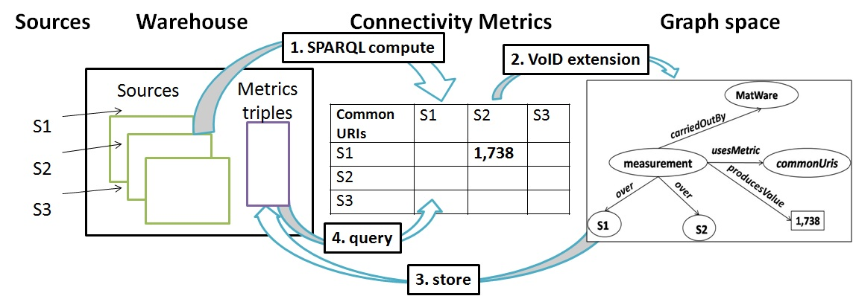
Connectivity Metrics: Exchanging (cont).
The entire process
1. Compute of the Connectivity Metrics-Production of Matrixes
2. Describe the Connectivity Metrics with the proposed VoID extension
3. Store these triples in a separate graph space
4. Retrieve/Query these values from the warehouse using SPARQL queries
Notes:
This expresses the entire process.

Slide 30
MarineTLO
MarineTLO-based
Warehouse
Ichthys
MatWare
XSearch
XLink

Slide 31
XSearch
A fully configurable meta-search engine the offers
Named Entity Extraction
Textual Clustering
Faceted search-like exploration
On-click semantic exploration of the identified entities
Entity discovery and exploration during plain web browsing

Slide 32
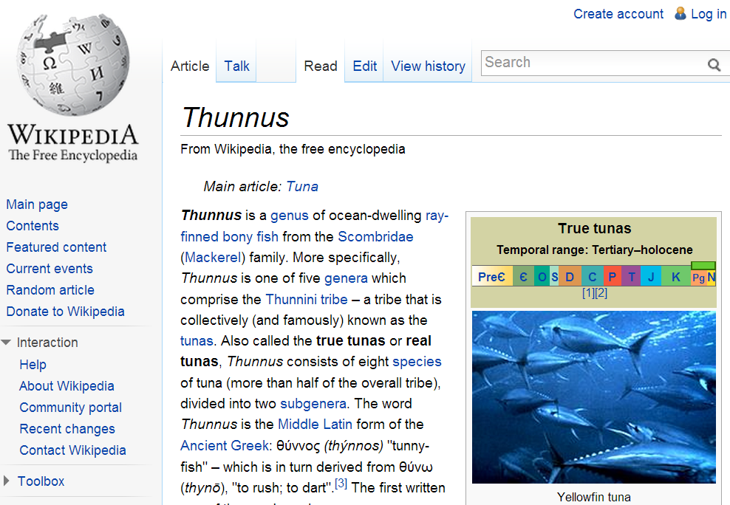




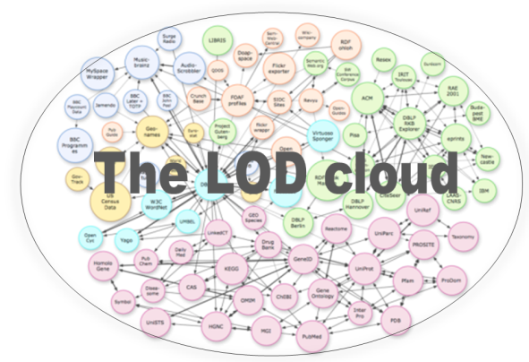
XSearch
web browsing
contents
query terms
(top-L) results
(+ metadata)
Entity
Mining
entities / contents
Visualization/Interaction (faceted search, entity exploration, annotation, top-k graphs, etc.)
Semantic Analysis
Retrieving more properties
Ranking
Grouping
…
semantic data

Slide 33
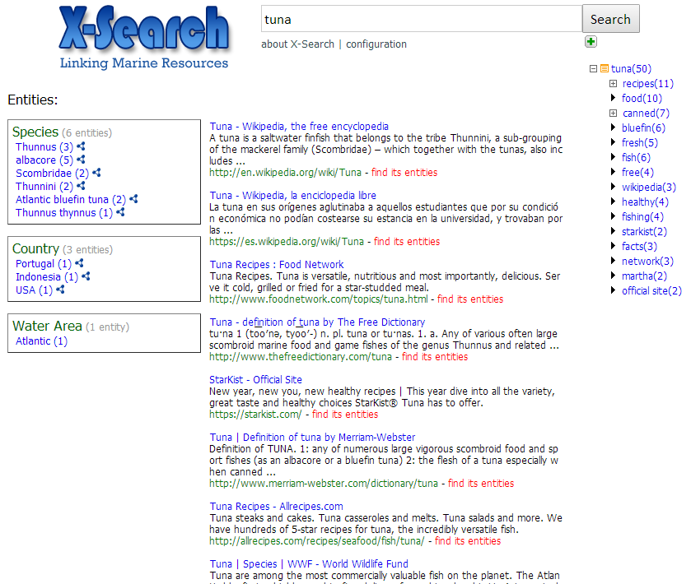
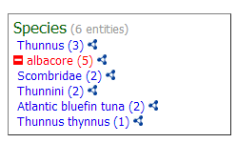
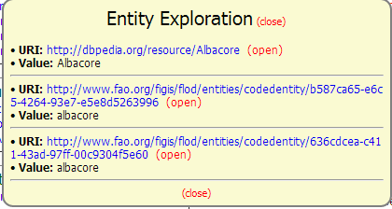
XSearch
Provision of Named Entity Recognition on the results
Fully configurable
Provision of textual clustering of the results
Faceted-like exploration of the search results
On-click semantic exploration of a knowledge base

Slide 34
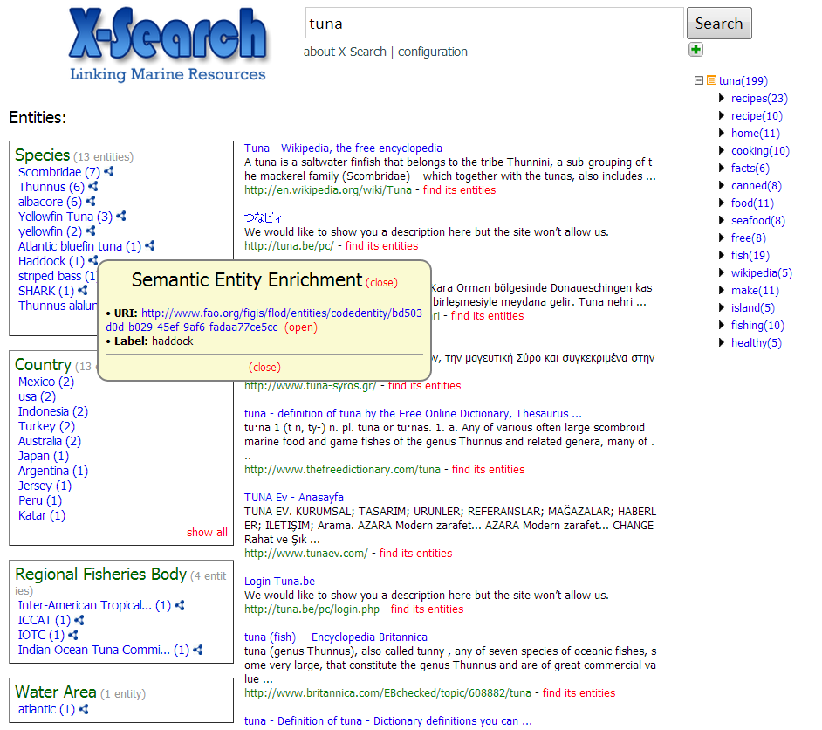
XSearch - Products
Web Application

Slide 35

Xsearch - Products
Portlet (developed with GWT)

Slide 36
XSearch - Products
Services
Main Services
Post-processing of search results
Match identified entity
Enrich identified entity
Identify entities from web accessible document
Supporting Services
Get the supported categories of entities
Get the supported clustering algorithms
Get the supported search systems

Slide 37

XSearch - Products
Bookmarklet

Slide 38
MarineTLO
MarineTLO-based
Warehouse
Ichthys
MatWare
XSearch
XLink

Slide 39






XLink -LOD-based Named Entity Extraction
named entity recognition
(using NLP/ML and/or Gazetteers)
Fish Species
chum salmon
coho salmon
atlantic Salmon
poacher
sockeye salmo
chinook salmon
entity linking
http://dbpedia.org/resource/Chum_salmon
kingdom: Animali
phylum: Chordata
class: Actinopterygii
order: Salmoniformes
binomial authority: J. Walbaum
entity enrichment
Notes:
A Linked Data-based NEE system first applies named entity recognition in a document. Note here that named entity recognition can be performed using Natural Language Processing methods, machine learning techniques, or Gazetteers. In all cases, the result is a set of entity names. For example, here we consider that the system has been configured to identify names of fish species, so in this case the entities are fishes.
Then, the system tries to link an identified entity name with semantic resources in the LOD cloud, that is with one or more URIs. For instance, in this example, the entity name “chum salmon” has been matched with a resource from DBpedia Knowledge Base.
Finally, the system can retrieve additional information regarding a resource, again by exploiting the LOD cloud. For instance, it can retrieve some properties, an image or other related entities.

Slide 40
XLink-Motivation
Configuring an existing Named Entity Extraction (NEE) system for building domain specific applications is…challenging!
It is a time consuming and laborious task (even for persons with computer science background) and requires many technical skills
Existing tools are mainly dedicated to one specific Knowledge Base which is indexed beforehand
thereby, they do not exploit the dynamic and distributed nature of LOD
In existing NEE tools, the user (an admin or a developer) cannot easily:
define its own interesting types/categories of entities
update/extend an existing category with additional entities coming from a new Knowledge Base (KB)
Specify how to link the identified entities with semantic resources
Control how to enrich the identified entities, i.e. configure the properties that are useful for a particular application, e.g. retrieve images, or a description in a specific language
Inspect whether and how the identified entities are connected not within the document but as entities in general
Notes:
The motivation is that while there are many tools that support Linked Data-based NEE like Dbpedia Spotlight, AlchemyAPI, OpenCalais, AIDA, etc. configuring one of these for building a domain specific application is very time consuming and laborious even for persons with computer science background.
In addition, existing tools are based on a specific Knowledge Base which is indexed beforehand, and so they cannot exploit the dynamic nature of LOD.

Slide 41

XLink Architecture

Slide 42

XLink -Configuration Model

Slide 43
XLink - Instantiation Example
SELECT DISTINCT str(?label) WHERE {
?uri rdf:type <http://dbpedia.org/ontology/Fish> .
?uri rdfs:label ?label FILTER(lang(?label)='en')
}
DBpedia Mirror
SPECIFICATION OF THE ENTITY NAMES
Fish Species
http://dbpedia.org/sparql
SELECT DISTINCT ?uri WHERE {
?uri rdf:type <http://dbpedia.org/ontology/Fish> .
?uri rdfs:label ?label FILTER(regex(str(?label), '[ENTITY]', 'i'))
}
FAO FLOD Mirror
http://www.fao.org.figis/flod/endpoint
LINKING TEMPLATE QUERY
Country
DBpedia Mirror_2
SELECT DISTINCT ?propertyName ?propertyValue
WHERE {
<[URI]> ?propertyName ?propertyValue
}
http://dbpedia.org/sparql
ENRICHING TEMPLATE QUERY
FactForge Mirror
http://factforge.net/sparql

Slide 44
XLink - Configurability
File-based configuration
x-link.properties
1 xlink.categories.supported = Fish;Country;Water_Area;Disease;Drug;Protein;Chemical_Substance
2 xlink.categories.active = Fish;Country;Water_Area
3 xlink.categories.Fish.kbms = dbpedia_fish
4 xlink.categories.Fish.kbms.dbpedia_fish.endpoint = http://dbpedia.org/sparql
5 xlink.categories.Fish.kbms.dbpedia_fish.resourceclasses = http://dbpedia.org/ontology/Fish; http://umbel.org/umbel/rc/Fish
6 xlink.categories.Fish.kbms.dbpedia_fish.templatequeries.linking = C:/tmpls/dbpFishLinking.sparql
7 xlink.categories.Fish.kbms.dbpedia_fish.templatequeries.linking.parameter = [ENTITY]
8 xlink.categories.Fish.kbms.dbpedia_fish.templatequeries.enriching = C:/tmpls/dbpFishEnrich.sparql
9 xlink.categories.Fish.kbms.dbpedia_fish.templatequeries.enriching.parameter = [URI]
10 xlink.connect.radius = 1
11 xlink.fuzzy = true
12 xlink.fuzzy.value = 0.2
Notes:
As regards configurability, X-Link fully supports the proposed configuration model described before.
On system startup, it reads a configuration from a properties file. This is an example of the properties file.
This file contains information about the supported categories, the KBMs, the template queries, etc.

Slide 45
XLink - Configurability
Configuration API
X-Link can be dynamically configured (even while a corresponding service is running)
Supported functions:
Add a new category (using a resource class or a SPARQL query)
Update an existing category (using a resource class or a SPARQL query)
Remove a category
Change the displayed name of a category
Set/change the KBMs of a category
Set/change the resource classes, the SPARQL queries and the SPARQL template queries of a KBM
Set/change the active categories
Set/change the value of radius “r”
Set/change if fuzzy matching is allowed and the allowed edit distance percentage
Notes:
An important feature of X-Link is that it can be dynamically configured through its API.
This allows its configuration even while a corresponding service is running.
Several functions are supported.
Each function changes accordingly the properties file and also updates several files in Gate Annie. For example, when a new category is created, the corresponding gazetteer file is created and loaded in Gate Annie and the name of the categories is added in the set of supported categories in the properties file.

Slide 46
XLink - Portability
The configuration files can be easily exchanged
Their size is relatively small
E.g., for supporting 4 categories related to the marine domain, the configuration files have size less than 5MB
The size mainly depends on the number of supported categories and on the number of the named entities in each category
X-Link does not store any semantic information (e.g. URIs or RDF triples)
The entity linking and entity enrichment processes are performed at real-time
Notes:
Another important feature is that the configuration files can be easily exchanged since their size is relatively small.
For example, consider that I configure X-Link and sends the configuration files to a friend of me. My friend can set X-link to use my configuration files and now he can enjoy exactly the same configuration.
Note that X-Link does not store any semantic information. The entity linking and entity enrichment processes are performed at real-time.

Slide 47


XLink – Handling Disambiguation
Notes:
To this end we introduce three methods, each approaching the problem from a different perspective. The first method is based exclusively on NEE results and selects as more probable category the one with the highest occurrence frequency. The second method moves a step forward and exploits the semantic relations between the mined entities, using their semantic resources, and returns the semantic resource that is closer to the others in the semantic graph. The last method uses machine learning algorithms for classifying the entire document into a specific category based on a train set

Slide 48
MarineTLO
MarineTLO-based
Warehouse
Ichthys
MatWare
XSearch
XLink

Slide 49
Links and References
http://www.ics.forth.gr/isl/MarineTLO
http://www.ics.forth.gr/isl/ontology/MarineTLO
http://www.ics.forth.gr/isl/Matware
http://www.ics.forth.gr/isl/X-Search
http://www.ics.forth.gr/isl/X-Link

Slide 50
Publications
P. Fafalios, I. Kitsos, Y. Marketakis, C. Baldassarre, M. Salampasis, Y. Tzitzikas. Web Searching with Entity Mining at Query Time. Multidisciplinary Information Retrieval, 5th International Retrieval Facility Conference, IRFC 2012, Vienna, Austria, July 2-3, 2012, Proceedings, pp 73-88, DOI 10.1007/978-3-642-31274-8_6.
P. Fafalios, I. Kitsos, Y. Tzitzikas. Scalable, flexible and generic instant overview search. In Proceedings of the 21st international conference companion on World Wide Web (WWW '12 Companion). ACM, New York, NY, USA, 333-336. DOI 10.1145/2187980.2188042.
P. Fafalios, M. Salampasis and Y. Tzitzikas. Exploratory Patent Search with Faceted Search and Configurable Entity Mining. Proceedings of the 1st International Workshop on Integrating IR technologies for Professional Search, in conjunction with the 35th European Conference on Information Retrieval (ECIR'13), Moscow, Russia. Paper in Volume 968 of CEUR Workshop Proceedings.
P. Fafalios and Y. Tzitzikas. X-ENS: Semantic Enrichment of Web Search Results at Real-Time, Demo Paper, Proceedings of the 36th International ACM SIGIR Conference on Research and Development in Information Retrieval (demo paper), SIGIR 2013, Dublin, Ireland.
Y. Tzitzikas, C. Allocca, C. Bekiari, Y. Marketakis, P. Fafalios, M. Doerr, N. Minadakis, T. Patkos and L. Candela. Integrating Heterogeneous and Distributed Information about Marine Species through a Top Level Ontology, 7th Metadata and Semantics Research Conference, MTSR 2013, Thessaloniki, Greece.

Slide 51
Publications
Y. Tzitzikas, C. Allocca, C. Bekiari, Y. Marketakis, P. Fafalios and N. Minadakis. Ontology-based Integration of Heterogeneous and Distributed Information of the Marine Domain, ERCIM News 2014 (96), Special theme: Linked Open Data, January 2014.
Y. Tzitzikas, N. Minadakis, Y. Marketakis, P. Fafalios, C. Alloca, and M. Mountantonakis. Quantifying the Connectivity of a Semantic Warehouse. In procs of the 4th International Workshop on Linked Web Data Management (LWDM 2014) 2014.
Y. Tzitzikas, N. Minadakis, Y. Marketakis, P. Fafalios, C. Alloca, M. Mountantonakis, I. Zidianaki. MatWare: Constructing and Exploiting Domain Specific Warehouses by Aggregating Semantic Data. In 11th Extended Semantic Web Conference (ESWC'14), Anissaras, Crete, Greece, May 2014.
M. Mountantonakis, C. Allocca, P. Fafalios, N. Minadakis, Y. Marketakis, C. Lantzaki, Y. Tzitzikas. Extending VoID for Expressing the Connectivity Metrics of a Semantic Warehouse, In 1st International Workshop on Dataset PROFILing & fEderated Search for Linked Data (PROFILES'14), co-located with ESWC'14, Anissaras, Crete, Greece, May 2014.
P. Fafalios, M. Baritakis, and Y. Tzitzikas. Configuring Named Entity Extraction through Real-Time Exploitation of Linked Data. 4th International Conference on Web Intelligence, Mining and Semantics (WIMS'14). Thessaloniki Greece, June 2014.

Slide 52
Publications
P. Fafalios and Y. Tzitzikas. Post-Analysis of Keyword-based Search Results using Entity Mining, Linked Data and Link Analysis at Query Time. 8th IEEE International Conference on Semantic Computing (ICSC 2014). Newport Beach, California, USA. June 2014.
P. Fafalios and Y. Tzitzikas. Exploratory Professional Search through Semantic Post-Analysis of Search Results, In “Professional Search in the Modern World”, Lecture Notes in Computer Science (LNCS), Springer, 2014 (accepted for publication as a State-of-the-Art volume in LNCS).
P. Fafalios and P. Papadakos. Theophrastus: On Demand and Real-Time Automatic Annotation and Exploration of (Web) Documents using Open Linked Data. Journal of Web Semantics: Science, Services and Agents on the World Wide Web, Elsevier (ISSN: 1570-8268), 2014.

Slide 53












People worked in iMarine
Administrative & Management
MarineTLO & Warehouse & Matware
XSearch
Ichthys
XLink
Administrative &
Management
Ioanna Zidianaki

Slide 54
Thank you !

